Slide 1
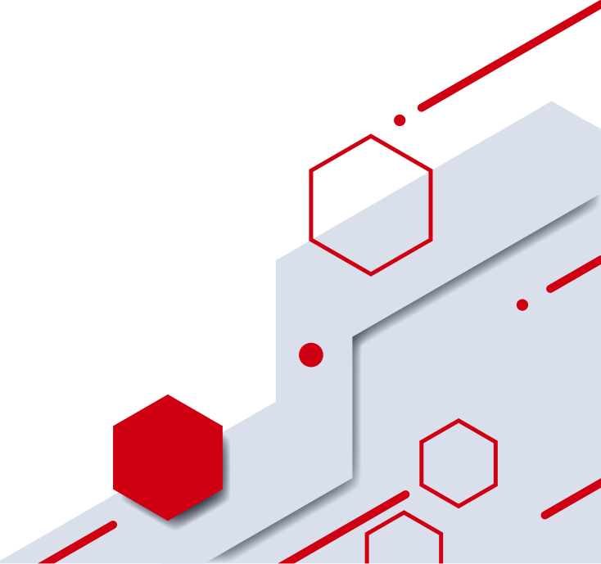
OAUTH2-BASED SOCIAL LOGIN INTEGRATION IN MERN STACK
GOOGLE & FACEBOOK AUTHENTICATION
Daksh Sehgal
Deepak Saini

Slide 2
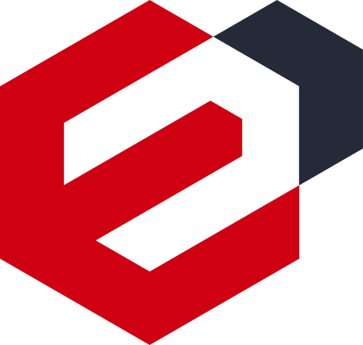


INTRODUCTION
•
OAuth2 login with Google & Facebook in MERN app
•
Uses Authorization Code Flow (PKCE)
•
Secure login with JWT (httpOnly cookies)
•
Handles signup, login & session management

Slide 3


ObjECTIVE
Enable quick social login
Secure user authentication
Support first-time & returning users
Seamless web & mobile experience

Slide 4

ArchITECTURE
Frontend (React): Starts OAuth flow
Backend (Node.js): Exchanges code for tokens
DB (MongoDB): Stores user data
Flow: Login → Code → Token → JWT session

Slide 5



ImpLEMENTATION
PKCE for token safety
JWT for secure sessions
Auto-create or fetch user profiles
Supports account link/unlink & logout

Slide 6


SecURITY
HTTPS & CSRF protection
Tokens never in localStorage
httpOnly cookie storage
Error & denial handling

Slide 7

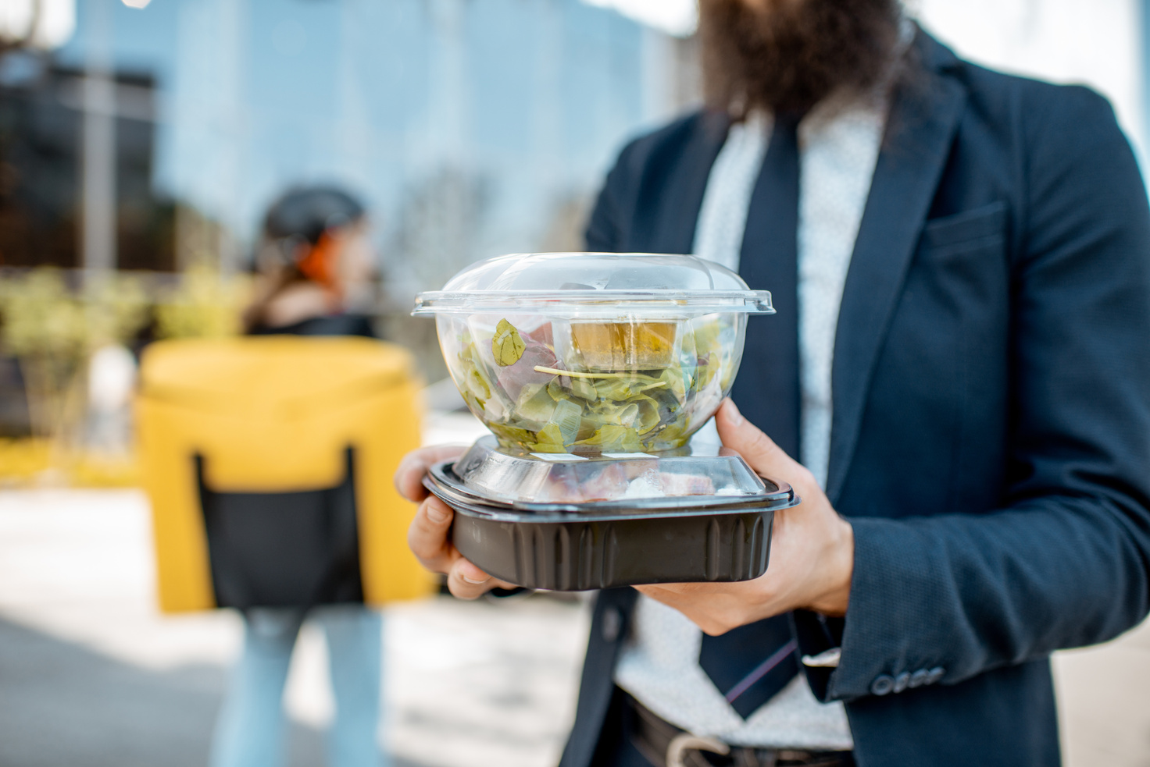
CONCLUSION
The implementation of OAuth2-based social login in a MERN application provides users with a secure, fast, and convenient way to authenticate using their existing Google or Facebook accounts. By leveraging the Authorization Code Flow with PKCE and secure JWT sessions, the system ensures strong protection against token theft and session hijacking. This approach not only enhances user experience by reducing the need for multiple passwords but also simplifies account management through automatic profile linking and secure session handling. Overall, the integration strengthens both the security and usability of the application, setting a solid foundation for adding future features like multi-factor authentication and support for additional identity providers.

